Slide 1
AMITY UNIVERSITY
B.C.A 2
TEAM 4

Slide 2
TEAM MEAMBERS
TANYA GUPTA (TEAM LEADER)
ALZABAT FIROZ
ADITI KESHRI
NIDHI RAJ
ZENNI RAJ
MADAN UPADHYAY
ABHIMAN PRATAP SINGH
MOHIT RAJ
CHANDRAJEET SINGH
MD ADIEB SIDDIQUE
SHAHID ZAFAR

Slide 3

PROJECT TITLE
YOUR FITNESS

Slide 4

PROJECT ICON

Slide 5
BLUE PRINT OF PROJECT

Slide 6
<?xml version="1.0" encoding="utf-8"?><androidx.constraintlayout.widget.ConstraintLayout xmlns:android="http://schemas.android.com/apk/res/android" xmlns:app="http://schemas.android.com/apk/res-auto" xmlns:tools="http://schemas.android.com/tools"
android:layout_width="match_parent" android:layout_height="match_parent" tools:context=".MainActivity"> <LinearLayout
android:layout_width="match_parent"
android:layout_height="match_parent" android:orientation="vertical"> <EditText
android:layout_width="match_parent" android:layout_height="wrap_content" android:hint="Enter
Your Name"
android:textSize="36sp" android:id="@+id/edtname"/> <RadioGroup

Slide 7
android:layout_width="wrap_content" android:layout_height="wrap_content"> <RadioButton
android:layout_width="match_parent"
android:layout_height="wrap_content" android:text="MALE" android:textSize="36sp" android:id="@+id/male"/> <RadioButton
android:layout_width="match_parent"
android:layout_height="wrap_content" android:text="FEMALE"
android:textSize="36sp"
android:id="@+id/female"/> </RadioGroup> <Button android:layout_width="wrap_content" android:layout_height="wrap_content" android:text="NEXT" android:textSize="20sp" android:id="@+id/done"/> <ImageView
android:layout_width="wrap_content"
android:layout_height="wrap_content" android:src="@drawable/handf" /> </LinearLayout>

Slide 8
</androidx.constraintlayout.widget.ConstraintLayout>
package mohit.projects.fitmuscles;
import androidx.appcompat.app.AppCompatActivity;
import android.os.Bundle;
import android.view.View;
import android.widget.AdapterView;
import android.widget.ArrayAdapter;
import android.widget.Button;
import android.widget.EditText;
import android.widget.ListView;
import android.widget.RadioButton;
import android.widget.Toast;
import java.util.ArrayList;public class MainActivity extends AppCompatActivity implements View.OnClickListener {
EditText name;
RadioButton male,female;
Button NEXT;
@Override
protected void onCreate(Bundle savedInstanceState) {

Slide 9
super.onCreate(savedInstanceState);
setContentView(R.layout.activity_main);
name=findViewById(R.id.edtname); male=findViewById(R.id.male);
female=findViewById(R.id.female);
NEXT=findViewById(R.id.done);
NEXT.setOnClickListener(this); }
@Override public void onClick(View v) { String name1=name.getText().toString();
String attachments="Your attachments are : ";
if (male.isChecked()){
attachments+="You are male"; }
if (female.isChecked()){
attachments+="You are female"; }
Toast.makeText(this, ""+attachments, Toast.LENGTH_SHORT).show();
}
}

Slide 10

FRONT PAGE

Slide 11
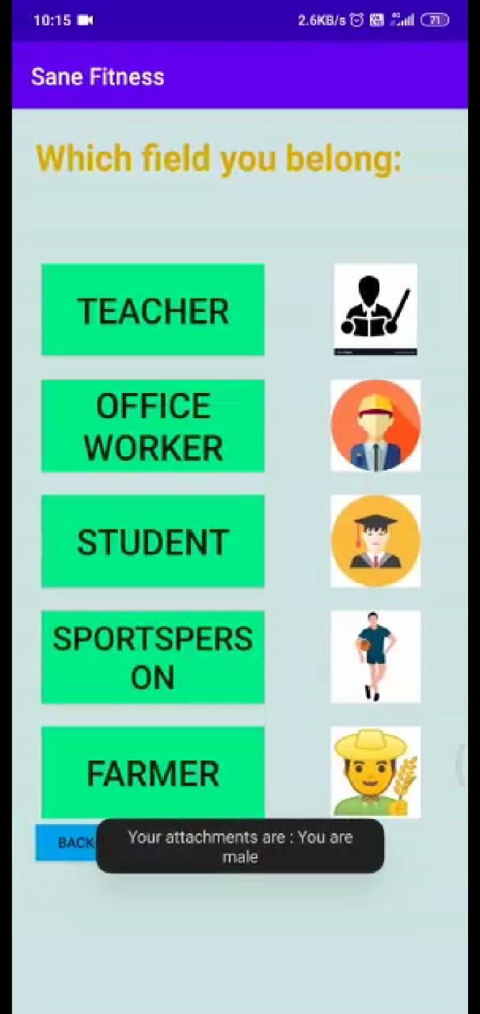
CHOSE THE FIELD YOU BELONG

Slide 12

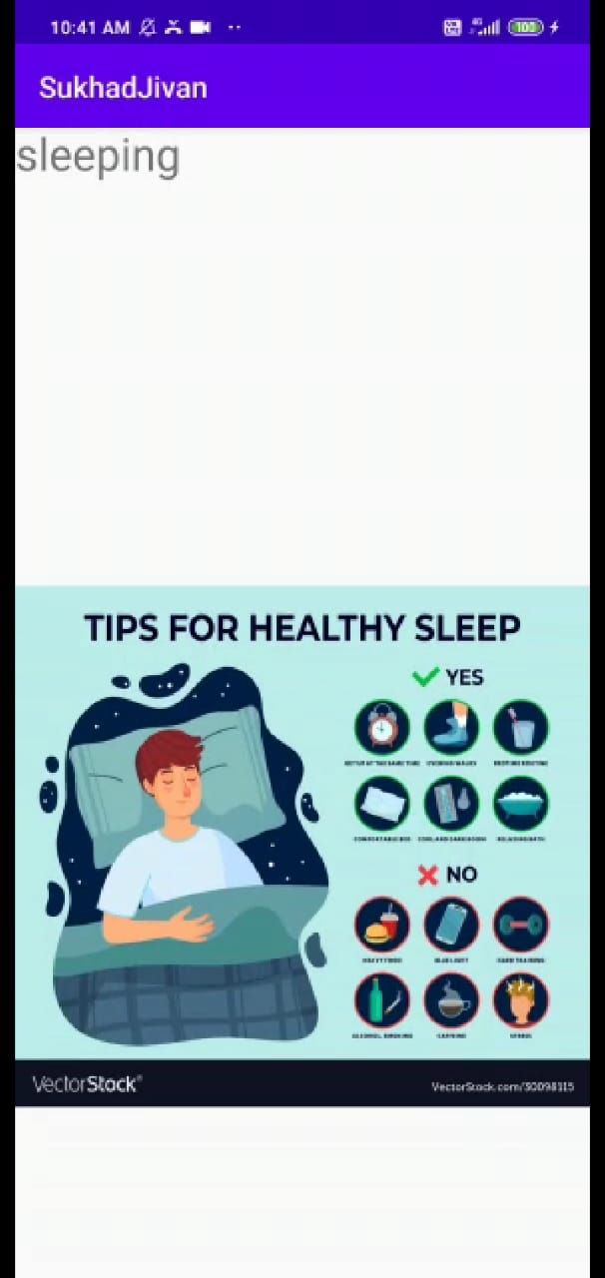
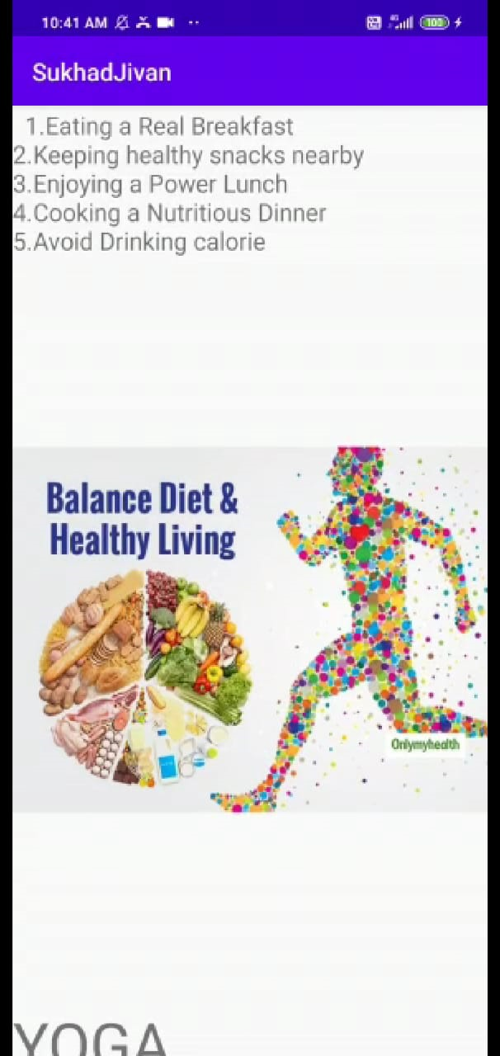
TEACHER

Slide 13
<androidx.core.widget.NestedScrollView
android:layout_width="match_parent" android:layout_height="match_parent"> <LinearLayout
android:layout_width="match_parent"
android:layout_height="match_parent" android:orientation="vertical"> <TextView
android:layout_width="match_parent"
android:layout_height="wrap_content" android:text="DIET" android:textSize="50sp"/> <TextView android:layout_width="match_parent" android:layout_height="wrap_content" android:text=" 1.Eating a Real Breakfast 2.Keeping healthy snacks nearby 3.Enjoying a Power Lunch 4.Cooking a Nutritious Dinner 5.Avoid droid:layout_height="wrap_content"
android:text="YOGA" android:textSize="50sp"/> <TextView android:layout_width="match_parent" android:layout_height="wrap_content" android:textSize="20sp" android:id="@+id/txtyoga" android:text=" Teaching is a tough profession.Heavy workloads,

Slide 14
challenging students, and lack of support are just some of the issues today's teachers have to handle. Yoga helps them in reducing stress ,anxiety,fatigue back pains,knee joint pain,etc.It also helps in increasing awarness and focus,and improves posture" /> <TextView android:layout_width="match_parent" android:layout_height="wrap_content" android:text="Tree Pose" android:textSize="50sp"/> <ImageView android:layout_width="match_parent" android:layout_height="wrap_content" android:src="@drawable/tree" android:id="@+id/imgtree" /> <TextView android:layout_width="match_parent" android:layout_height="wrap_content" android:text="Mountain Pose" android:textSize="50sp"/> <ImageView android:layout_width="match_parent" android:layout_height="wrap_content" android:src="@drawable/mountain" android:id="@+id/imgmountain" /> <TextView android:layout_width="match_parent"

Slide 15
android:layout_width="match_parent" android:layout_height="wrap_content" android:src="@drawable/bend" android:id="@+id/imgbend" /> <TextView android:layout_width="match_parent" android:layout_height="wrap_content" android:text="SLEEP" android:textSize="50sp"/> <TextView android:layout_width="match_parent" android:layout_height="wrap_content" android:text=" Sleep for teachers is an elusive thing. People who are sleep deprived have less energy, more difficulty focusing on tasks, and will find it harder to maintain optimal physical fitness. They should take 8 hours of sleep. " android:id="@+id/txtsleep" android:textSize="20sp" /> <TextView android:layout_width="match_parent" android:layout_height="wrap_content" android:text="This picture shows what to do and what don'tdo before sleeping" android:textSize="30sp"/> <ImageView android:layout_width="match_parent" android:layout_height="wrap_content"

Slide 16
android:src="@drawable/sleep" android:id="@+id/imgsleep" android:layout_alignParentBottom="true"/> <Button android:layout_width="wrap_content" stedScrollView>
android:layout_height="wrap_content" android:src="@drawable/sleep" android:id="@+id/imgsleep" android:layout_alignParentBottom="true"/> <Button android:layout_width="wrap_content" android:layout_height="wrap_content" android:text="Back" android:textSize="40sp" android:id="@+id/btnback"/> </LinearLayout> </androidx.core.widget.NestedScrollView>

Slide 17
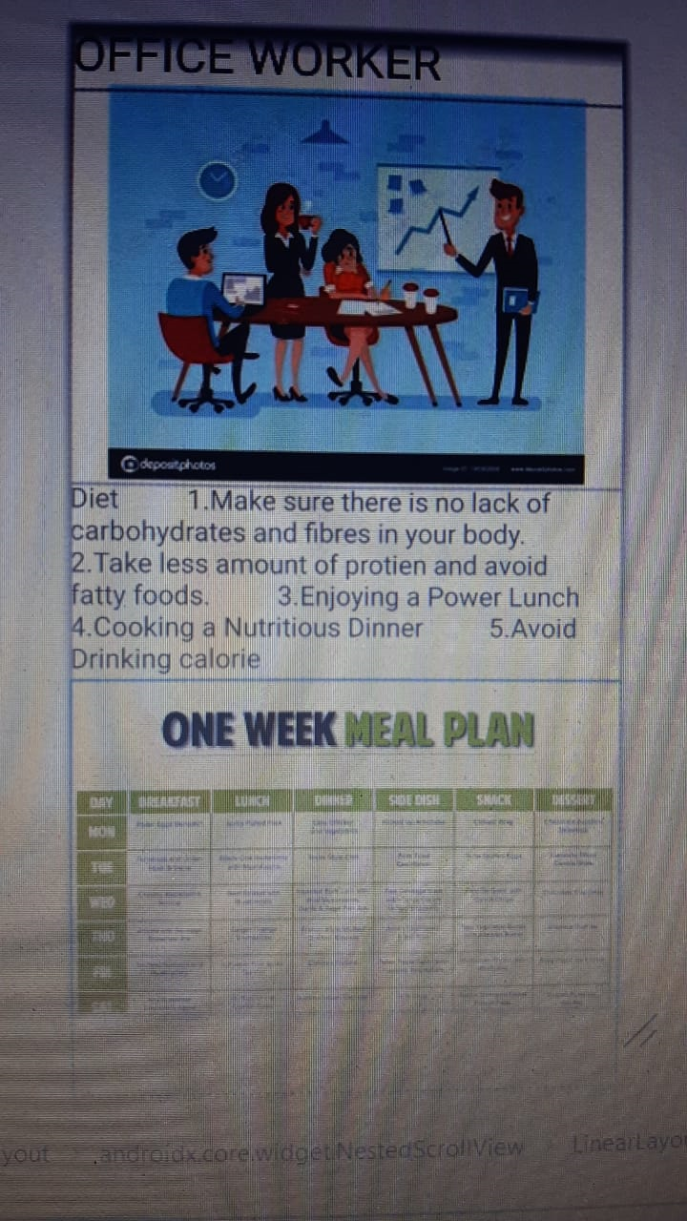
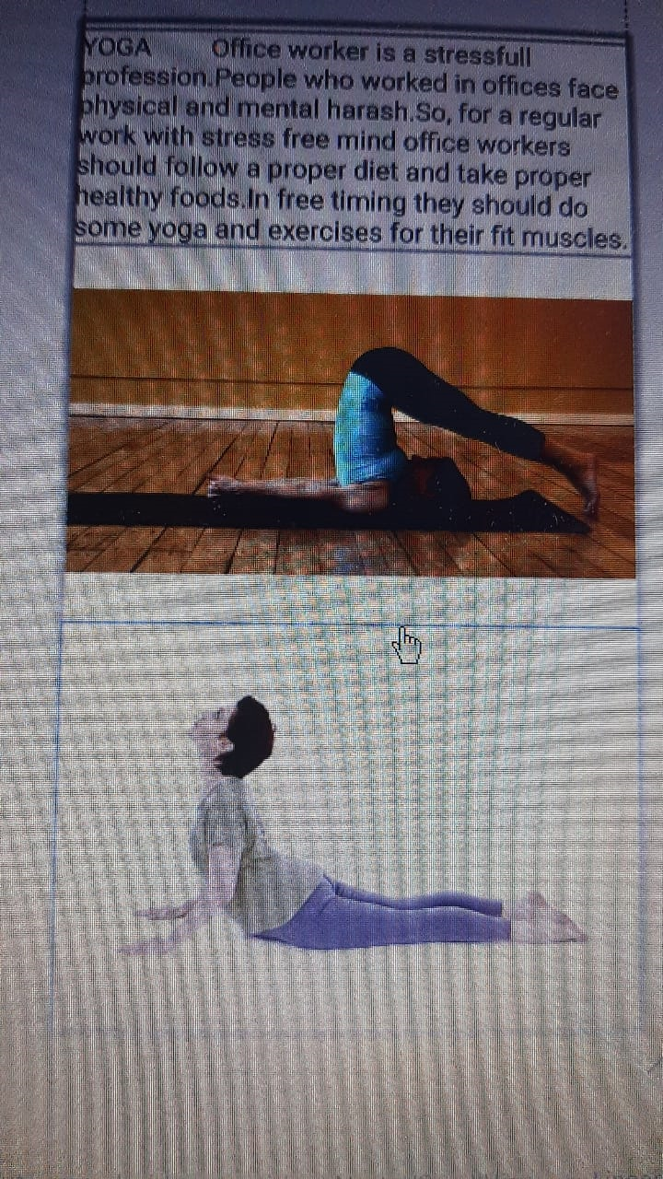
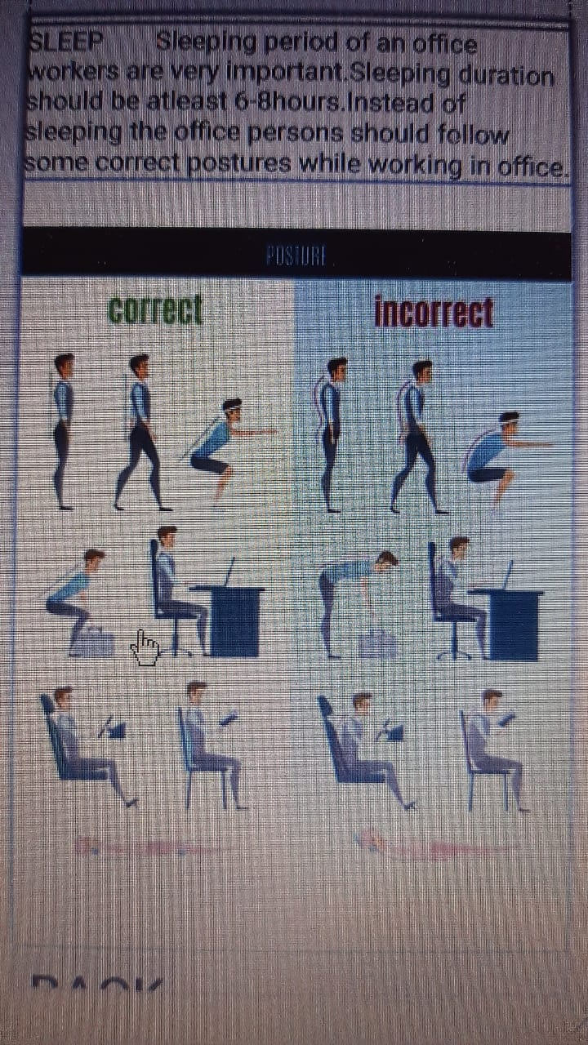
OFFICE WORKER

Slide 18
<?xml version="1.0" encoding="utf-8"?><androidx.constraintlayout.widget.ConstraintLayout xmlns:android="http://schemas.android.com/apk/res/android" xmlns:app="http://schemas.android.com/apk/res-auto" xmlns:tools="http://schemas.android.com/tools" android:layout_width="match_parent" android:layout_height="match_parent" tools:context=".MainActivity"> <androidx.core.widget.NestedScrollView android:layout_width="match_parent" android:layout_height="match_parent"> <LinearLayout android:layout_width="match_parent" android:layout_height="match_parent" android:orientation="vertical"> <TextView android:layout_width="match_parent" android:layout_height="wrap_content" android:text="OFFICE WORKER" android:textSize="36sp"/> <ImageView android:id="@+id/imagediet" android:layout_width="match_parent" android:layout_height="wrap_content"

Slide 19
android:src="@drawable/pics1" /> <TextView android:layout_width="match_parent" android:layout_height="wrap_content" android:text="Diet 1.Make sure there is no lack of carbohydrates and fibres in your body. 2.Take less amount of protien and avoid fatty foods. 3.Enjoying a Power Lunch 4.Cooking a Nutritious Dinner 5.Avoid Drinking calorie" android:textSize="20sp" android:id="@+id/txtdiet" /> <ImageView android:id="@+id/officediets" android:layout_width="match_parent" android:layout_height="312dp" android:src="@drawable/officediets" /> <TextView android:layout_width="match_parent" android:layout_height="wrap_content" android:textSize="20sp" android:id="@+id/txtyoga" android:text="YOGA Office worker is a stressfull profession.People who worked in offices face physical and mental harash.So, for a regular work with stress free mind office workers should follow a proper diet and take proper healthy foods.In free timing they should do some yoga and exercises for

Slide 20
their fit muscles." /> <ImageView android:id="@+id/yog1" android:layout_width="match_parent" android:layout_height="274dp" android:src="@drawable/yog1" /> <ImageView android:layout_width="match_parent"
android:layout_height="wrap_content" android:src="@drawable/yog2" android:id="@+id/yog2" /> <ImageView android:id="@+id/yog3" android:layout_width="match_parent" android:layout_height="828dp" android:src="@drawable/yog3" /> <TextView android:layout_width="match_parent" android:layout_height="wrap_content" android:text="SLEEP Sleeping period of an office workers are very important.Sleeping duration should be atleast 6-8hours.Instead of sleeping the office persons should follow some correct postures while working in office. “

Slide 21
android:id="@+id/txtsleep" android:textSize="20sp" /> <ImageView android:layout_width="match_parent" android:layout_height="wrap_content" android:src="@drawable/yog4" android:id="@+id/yog4" android:layout_alignParentBottom="true"/> <Button…

Slide 22

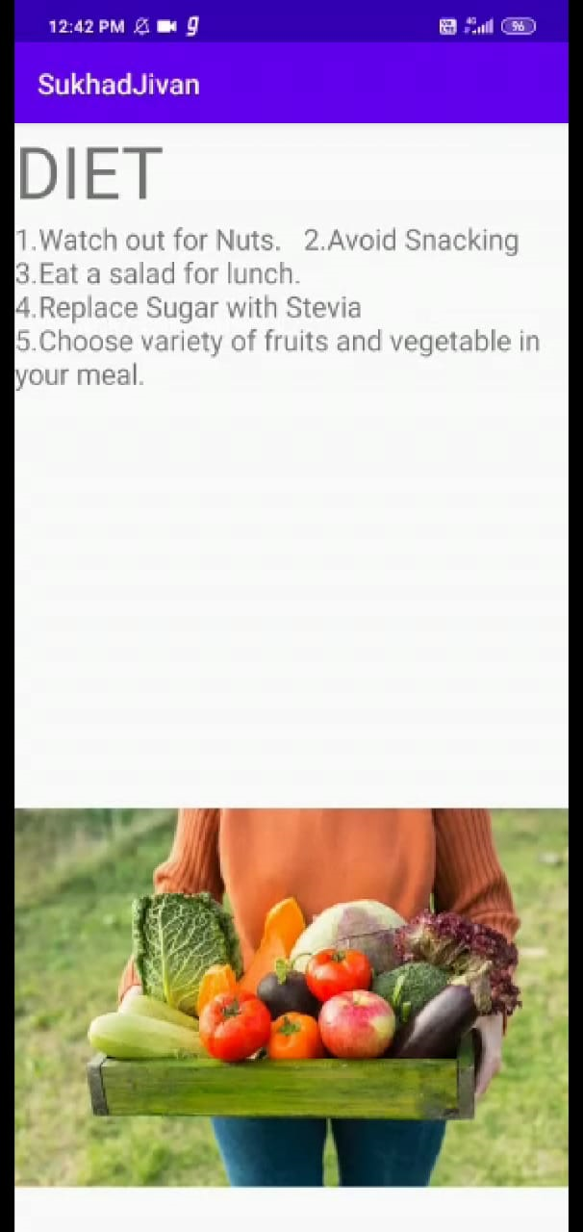
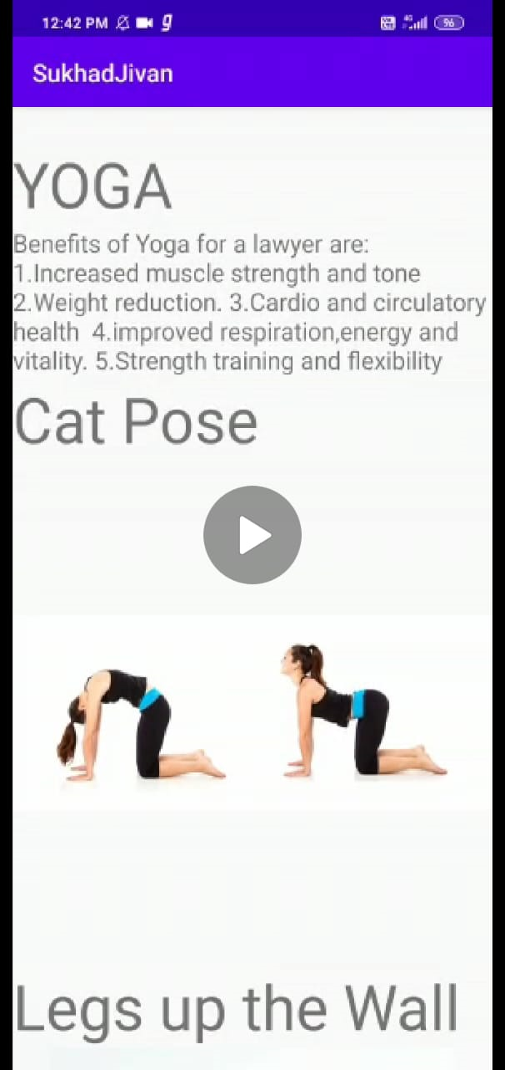
STUDENT

Slide 23
<androidx.core.widget.NestedScrollView android:layout_width="match_parent" android:layout_height="match_parent"> <LinearLayout android:layout_width="match_parent" android:layout_height="match_parent" android:orientation="vertical"> <TextView android:layout_width="match_parent" android:layout_height="wrap_content" android:text="DIET" android:textSize="50sp"/> <TextView android:layout_width="wrap_content" android:layout_height="wrap_content" android:text="1.Watch out for Nuts. 2.Avoid Snacking 3.Eat a salad for lunch. 4.Replace Sugar with Stevia 5.Choose variety of fruits and vegetable in your meal." android:textSize="20sp" android:id="@+id/txtdiet" /> <ImageView android:id="@+id/imagefruit" android:layout_width="wrap_content" android:layout_height="match_parent" android:src="@drawable/fruit" /> <TextView android:layout_width="match_parent”

Slide 24
android:layout_height="wrap_content" android:text="YOGA" android:textSize="50sp"/> <TextView android:layout_width="match_parent"
android:layout_height="wrap_content" android:textSize="20sp" android:id="@+id/txtyoga" android:text="Benefits of Yoga for a student are: 1.Increased muscle strength and tone2.Weight reduction.3.Cardio and circulatory health 4.improved respiration,energy and vitality.5.Strength training and flexibility"/> <TextView android:layout_width="match_parent" android:layout_height="wrap_content" android:text="Cat Pose" android:textSize="50sp"/> <ImageView android:layout_width="match_parent" android:layout_height="wrap_content" android:src="@drawable/first" android:id="@+id/imgfirst" /> <TextView android:layout_width="match_parent" android:layout_height="wrap_content" android:text="Legs up the Wall" android:textSize="50sp"/> <ImageView android:layout_width="match_parent" "

Slide 25
android:layout_height="wrap_content" android:src="@drawable/second" android:id="@+id/imgsecond" /> <TextView android:layout_width="match_parent" android:layout_height="wrap_content"
android:text="Surya Namskar " android:textSize="50sp"/> <ImageView android:layout_width="match_parent" android:layout_height="wrap_content" android:src="@drawable/third" android:id="@+id/imgthird" /> <TextView android:layout_width="match_parent" android:layout_height="wrap_content" android:text="SLEEP" android:textSize="50sp"/> <TextView android:layout_width="match_parent" android:layout_height="wrap_content" android:text="Healthy sleep can help your body better regulate blood sugar levels,keep your immune system functioning properly and even improve your heart health by decreasing stress " android:id="@+id/txtsleep" android:textSi…

Slide 26
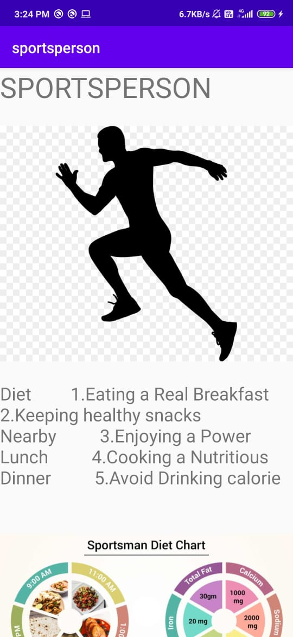
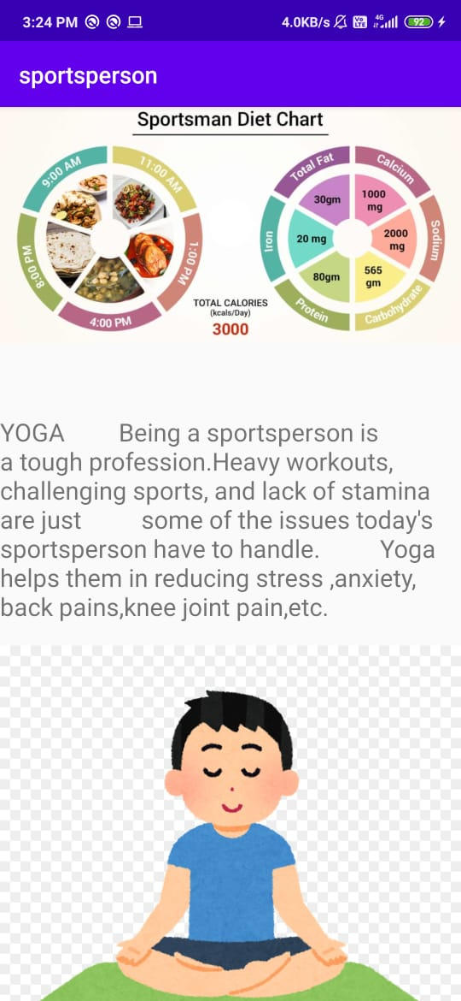
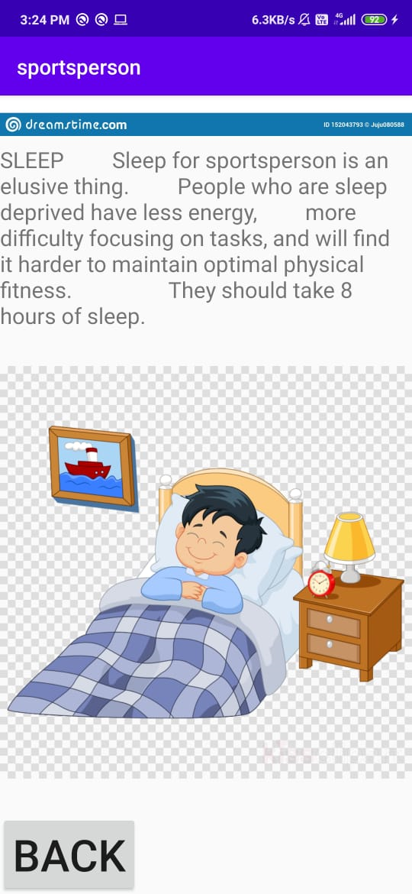
SPORTS PERSON

Slide 27
?xml version="1.0" encoding="utf-8"?><androidx.constraintlayout.widget.ConstraintLayout xmlns:android="http://schemas.android.com/apk/res/android" xmlns:app="http://schemas.android.com/apk/res-auto" xmlns:tools="http://schemas.android.com/tools" android:layout_width="match_parent" android:layout_height="match_parent" tools:context=".MainActivity"> <androidx.core.widget.NestedScrollView android:layout_width="match_parent" android:layout_height="match_parent"> <LinearLayout android:layout_width="match_parent" android:layout_height="match_parent" android:orientation="vertical"> /> <TextView android:layout_width="match_parent" android:layout_height="wrap_content" android:text="SPORTSPERSON" android:textSize="36sp" /> <ImageView android:layout_width="match_parent" android:layout_height="368dp" android:src="@drawable/pic1" /> <TextView android:layout_width="match_parent" android:layout_height="wrap_content"

Slide 28
android:text="Diet 1.Eating a Real Breakfast 2.Keeping healthy snacks Nearby 3.Enjoying a Power Lunch 4.Cooking a Nutritious Dinner 5.Avoid Drinking calorie" android:textSize="23sp" android:id="@+id/txtdiet" /> <ImageView android:id="@+id/spdiets" android:layout_width="match_parent" android:layout_height="326dp" android:src="@drawable/spdiets" /> <TextView android:layout_width="match_parent" android:layout_height="wrap_content" android:textSize="20sp" android:id="@+id/txtyoga" android:text="YOGA Being a sportsperson is a tough profession.Heavy workouts, challenging sports, and lack of stamina are just some of the issues today's sportsperson have to handle. Yoga helps them in reducing stress ,anxiety, back pains,knee joint pain,etc." /> <ImageView android:id="@+id/yoga" android:layout_width="match_parent" android:layout_height="388dp" android:src="@drawable/yoga" /> <ImageView

Slide 29
android:id="@+id/imgyoga3" android:layout_width="match_parent" android:layout_height="631dp" android:src="@drawable/yoga3" /> <ImageView android:id="@+id/imgyoga2" android:layout_width="match_parent" android:layout_height="431dp" android:src="@drawable/yoga2" /> <TextView android:layout_width="match_parent" android:layout_height="wrap_content" android:text="SLEEP Sleep for sportsperson is an elusive thing. People who are sleep deprived have less energy, more difficulty focusing on tasks, and will find it harder to maintain optimal physical fitness. They should take 8 hours of sleep. " android:id="@+id/txtsleep" android:textSize="20sp" /> <ImageView android:id="@+id/imgrest" android:layout_width="match_parent" android:layout_height="461dp" android:layout_alignParentBottom="true" android:src="@drawable/rest" /> <Button

Slide 30
android:layout_width="wrap_content" android:layout_height="wrap_content" android:text="Back" android:textSize="40sp" android:id="@+id/btnback" /> </LinearLayout> </androidx.core.widget.NestedScrollView>

Slide 31
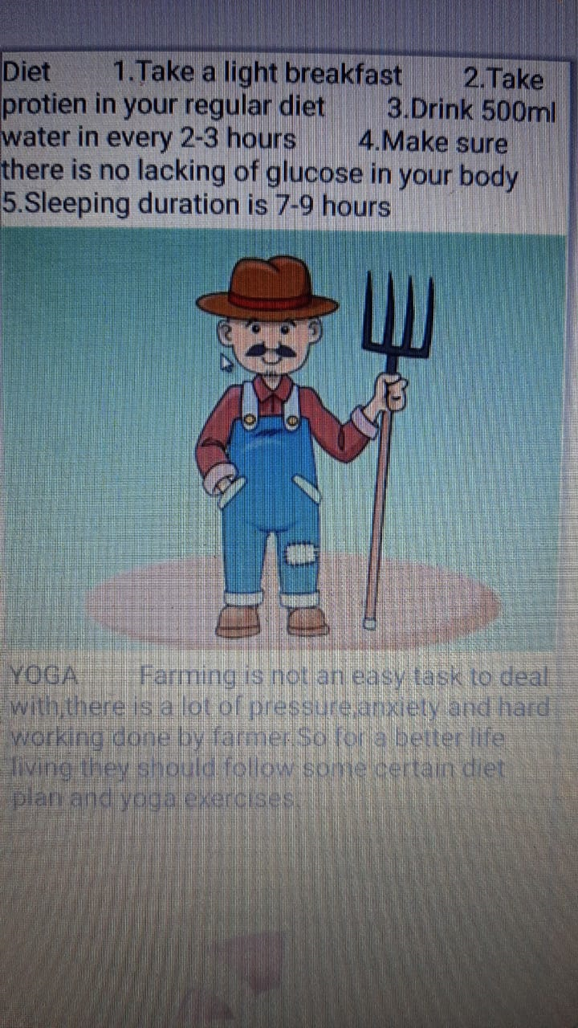

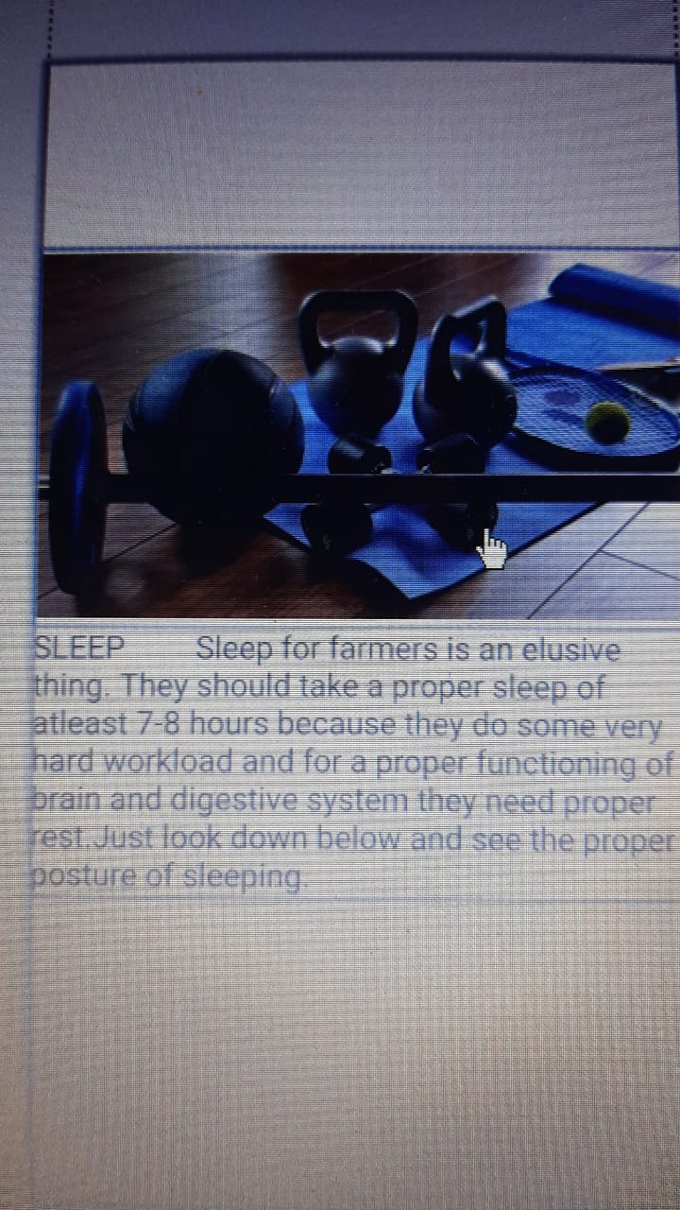
FARMER

Slide 32
<?xml version="1.0" encoding="utf-8"?><androidx.constraintlayout.widget.ConstraintLayout xmlns:android="http://schemas.android.com/apk/res/android" xmlns:app="http://schemas.android.com/apk/res-auto" xmlns:tools="http://schemas.android.com/tools" android:layout_width="match_parent" android:layout_height="match_parent" tools:context=".MainActivity"> <androidx.core.widget.NestedScrollView android:layout_width="match_parent" android:layout_height="match_parent"> <LinearLayout android:layout_width="match_parent" android:layout_height="match_parent" android:orientation="vertical" tools:ignore="HardcodedText"> <TextView android:layout_width="match_parent" android:layout_height="wrap_content" android:text="FARMER" android:textSize="36sp"/> <ImageView android:id="@+id/imagediet" android:layout_width="match_parent" android:layout_height="wrap_content" android:src="@drawable/farmer" /> <TextView

Slide 33
android:id="@+id/txtdiet" android:layout_width="match_parent" android:layout_height="wrap_content" android:text="Diet 1.Take a light breakfast 2.Take protien in your regular diet 3.Drink 500ml water in every 2-3 hours 4.Make sure there is no lacking of glucose in your body 5.Sleeping duration is 7-9 hours" android:textSize="20sp" /> <ImageView android:id="@+id/dietplan1" android:layout_width="match_parent" android:layout_height="316dp" android:src="@drawable/dietplan1" /> <TextView android:layout_width="match_parent" android:layout_height="wrap_content" android:textSize="20sp" android:id="@+id/txtyoga" android:text="YOGA Farming is not an easy task to deal with,there is a lot of pressure,anxiety and hard working done by farmer.So for a better life living they should follow some certain diet plan and yoga exercises." /> <ImageView android:layout_width="match_parent" android:layout_height="wrap_content" android:src="@drawable/exercise1" android:id="@+id/exercise1" /> <ImageView

Slide 34
android:id="@+id/exercise2" android:layout_width="match_parent" android:layout_height="222dp" android:src="@drawable/exercise2" /> <ImageView android:layout_width="match_parent" android:layout_height="wrap_content" android:src="@drawable/oip" android:id="@+id/oip" /> <TextView android:layout_width="match_parent" android:layout_height="wrap_content" android:text="SLEEP Sleep for farmers is an elusive thing. They should take a proper sleep of atleast 7-8 hours because they do some very hard workload and for a proper functioning of brain and digestive system they need proper rest.Just look down below and see the proper posture of sleeping." android:id="@+id/txtsleep" android:textSize="20sp" /> <ImageView android:id="@+id/imgsleeps" android:layout_width="match_parent" android:layout_height="410dp"

Slide 35
android:layout_alignParentBottom="true" android:src="@drawable/sleeps" /> <Button android:layout_width="wrap_content" android:layout_height="wrap_content" android:text="Back" android:textSize="40sp" android:id="@+id/btnback" /> </LinearLayout> </androidx.core.widget.NestedScrollView></androidx.constraintlayout.widget.ConstraintLayout>

Slide 36
THANK YOU
END

